Slide 1
BMD ENG 301 Quantitative Systems Physiology (Nervous System)
Cerebellum
2022_v1
Professor Malcolm MacIver

Slide 2
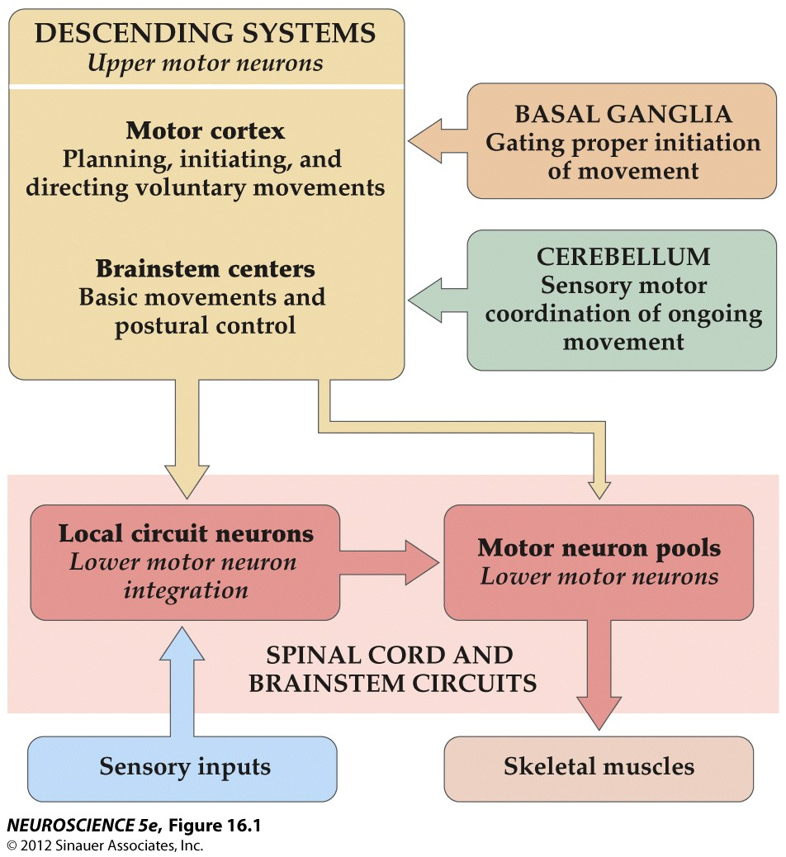
Organization of neural structures involved in the control of movement

Slide 3
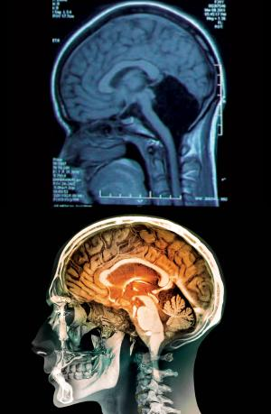

Slide 4
What does the cerebellum do?
Right cerebellum for right side of the body, Left cerebellum for left side of the body
Minimizing motor error (efference copy)
Feedback
Learning – LTP/LTD

Slide 5
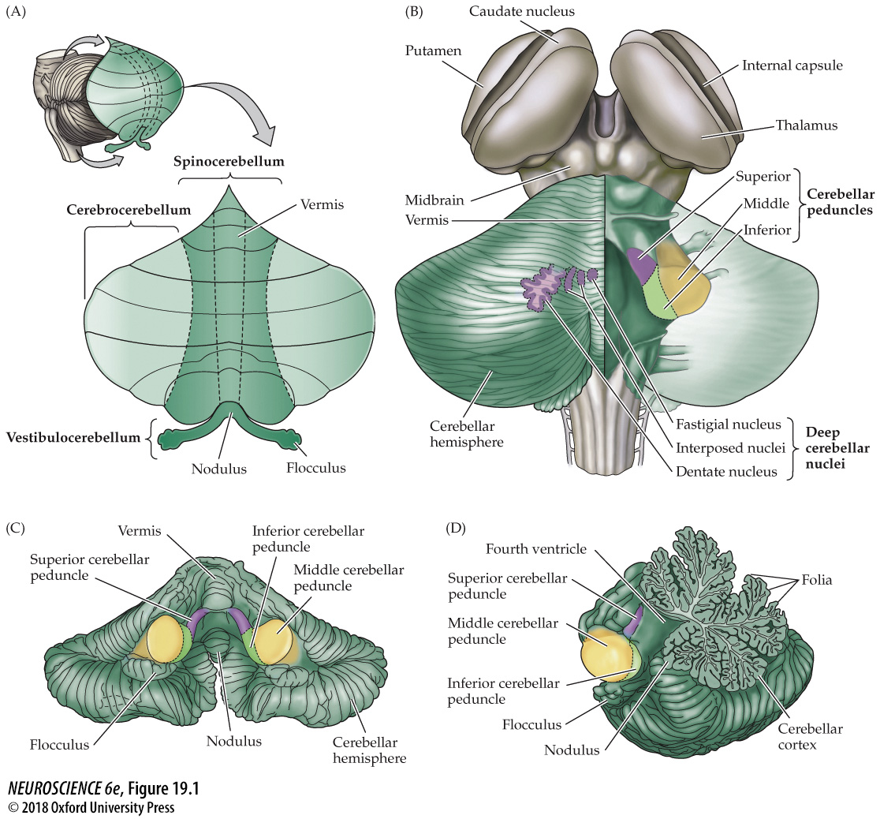
Organization and subdivisions of the cerebellum

Slide 6
Divisions of the Cerebellum
Cerebrocerebellum – regulation of highly skilled movements, especially the planning and execution of complex spatial and temporal sequences of movement (including speech)
Vestibulocerebellum – regulation of movements underlying posture and equilibrium
Spinocerebellum – movements of the distal muscles, such as movements of the limbs in walking, movements of proximal muscles and regulation of eye movements in response to vestibular inputs

Slide 7
Organization and subdivisions of the cerebellum

Slide 8
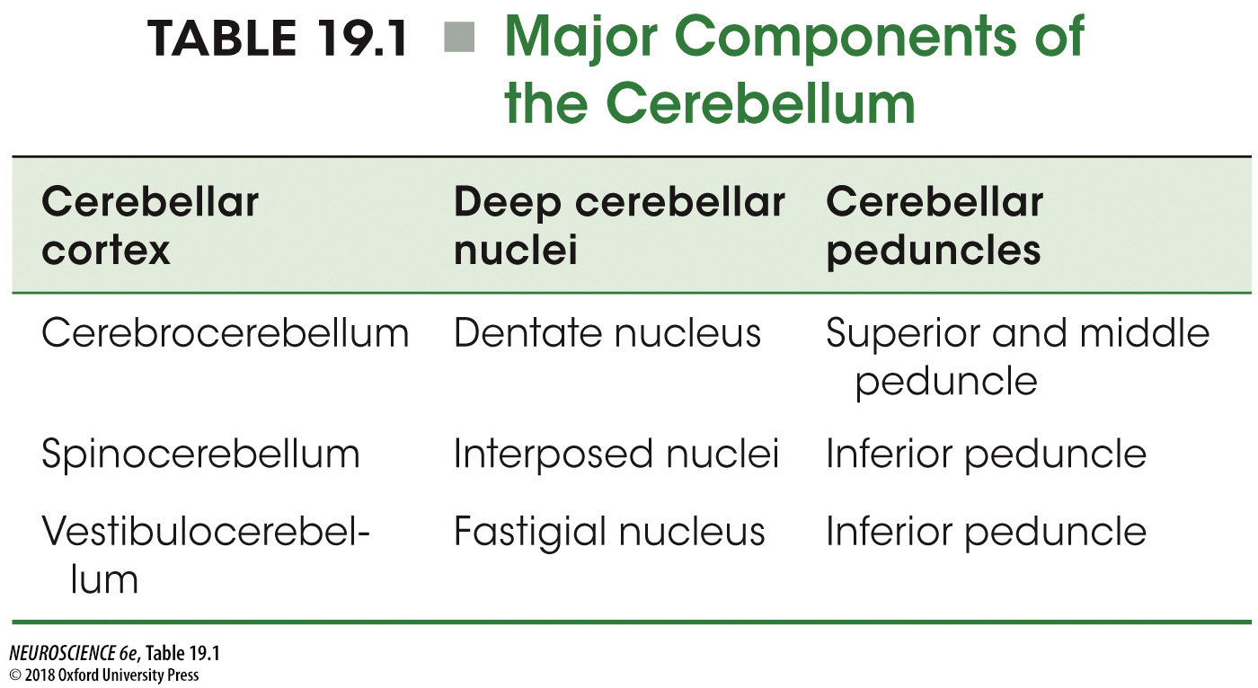
Major Components of the Cerebellum
Exception: Output from vestibulocerebellum to vestibular nuclei – does not pass through a deep cerebellar nucleus

Slide 9
Organization and subdivisions of the cerebellum

Slide 10
Afferents and Efferents
Superior peduncle – mostly efferents from deep cerebellar nuclei – headed to red nucleus, deep layers of the superior colliculus and motor and premotor cortex via a thalamic relay
Middle peduncle – mostly afferents from pontine nuclei ( > 40 million axons) – pons receives input from almost all of the cerebral cortex and the superior colliculus
Inferior peduncle – afferents and efferents – input from the vestibular nuclei, spinal cord and brainstem tegmentum – Brainstem input from the inferior olive and the locus coeruleus involved in learning and memory functions

Slide 11
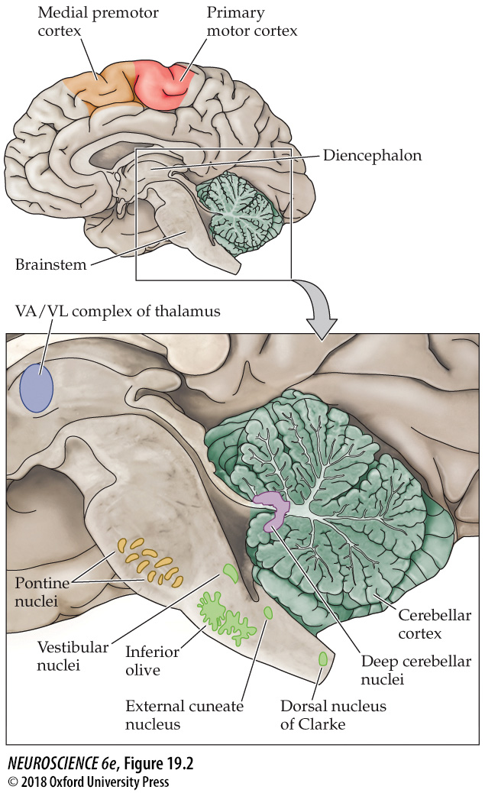
Components of the brainstem and diencephalon related to the cerebellum

Slide 12
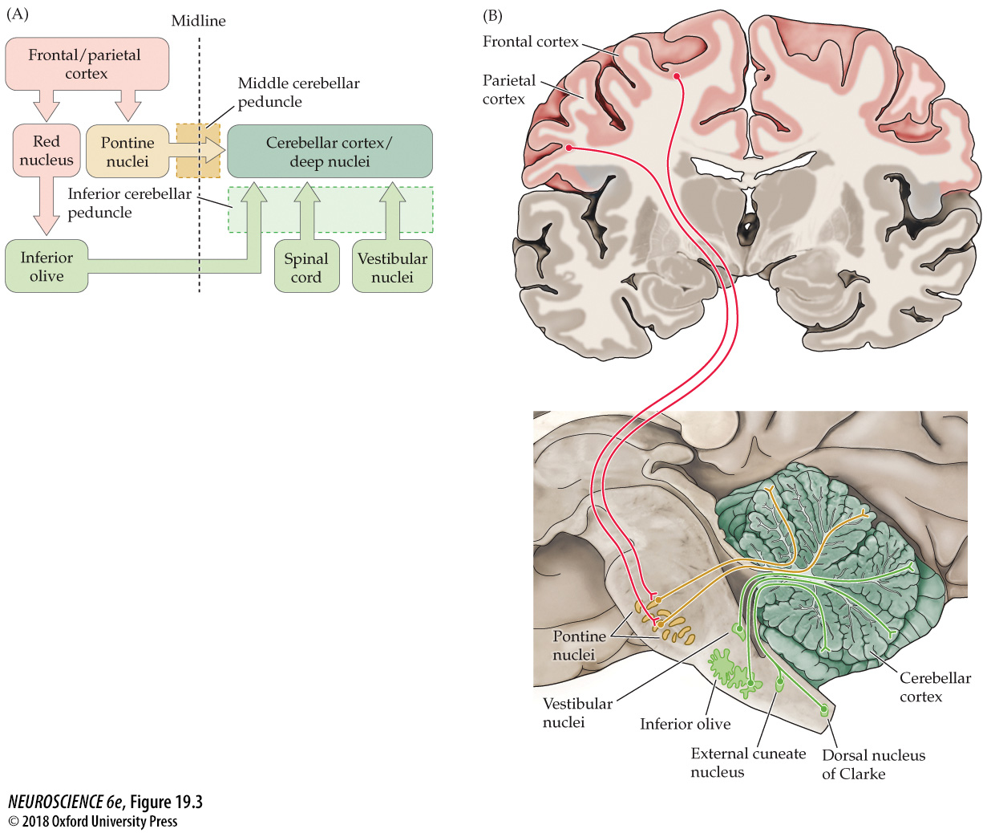
Functional organization of the inputs to the cerebellum

Slide 13
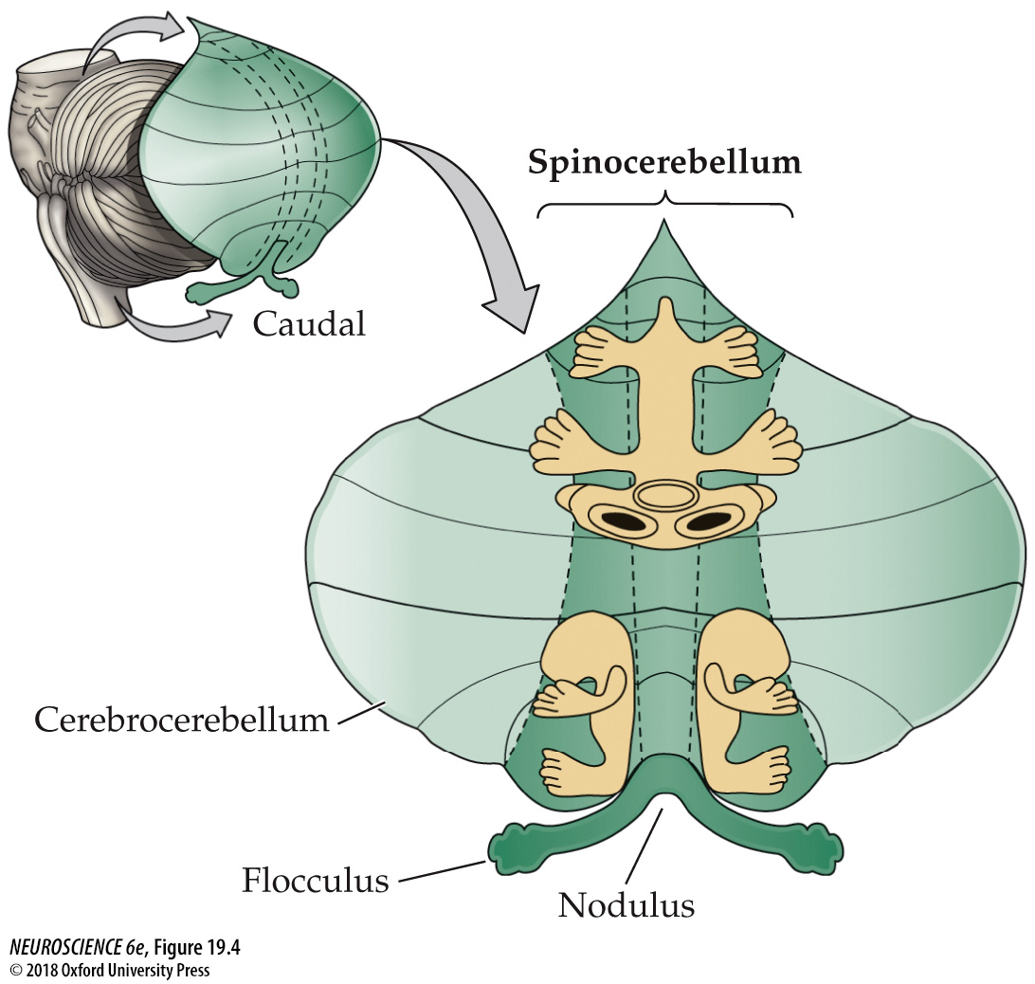
Somatotopic maps of the body surface in the cerebellum

Slide 14
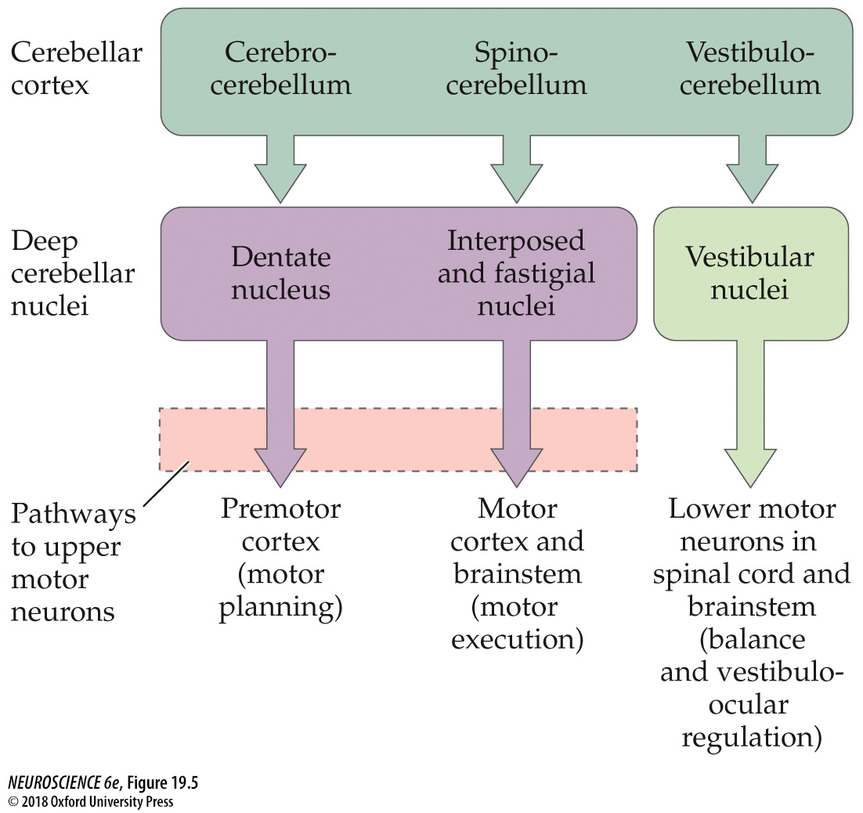
Functional organization of cerebellar outputs

Slide 15
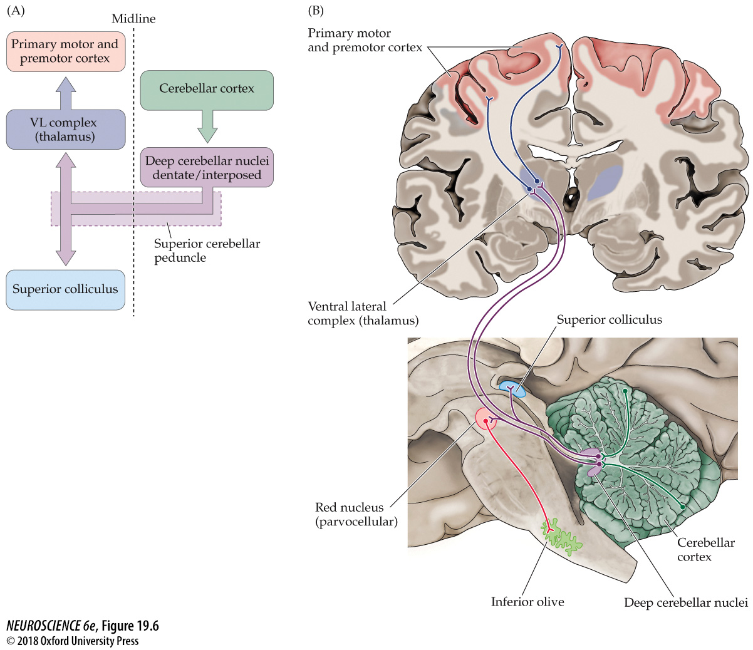
Functional organization of the major outputs from the cerebellum to cortical motor systems

Slide 16
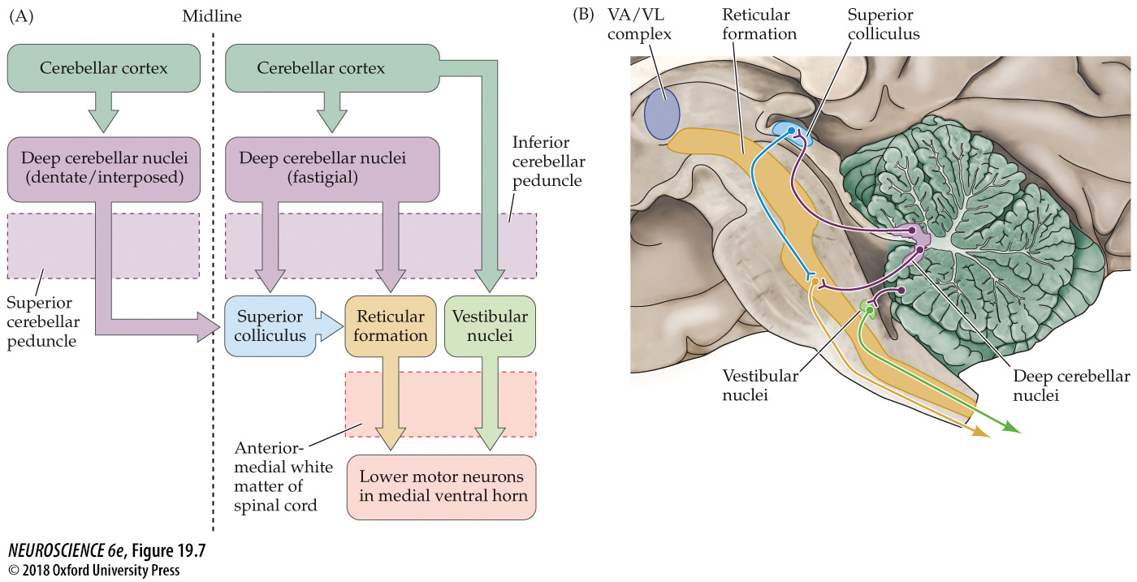
Functional organization of the major outputs from the cerebellum to brainstem motor systems

Slide 17
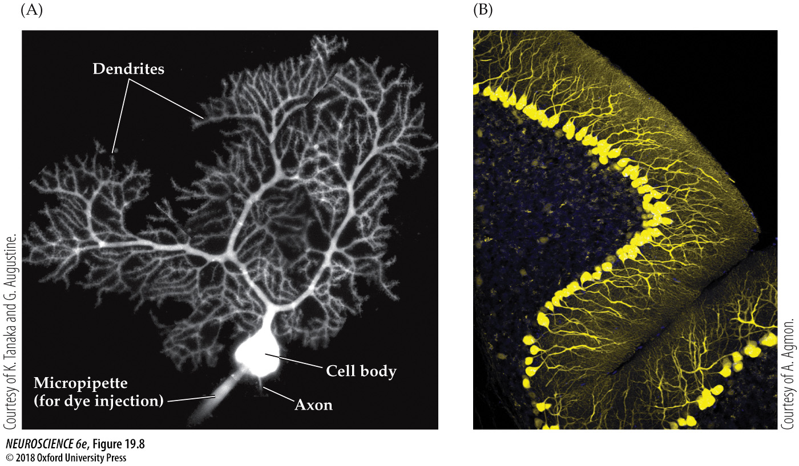
Cerebellar cortical neurons

Slide 18
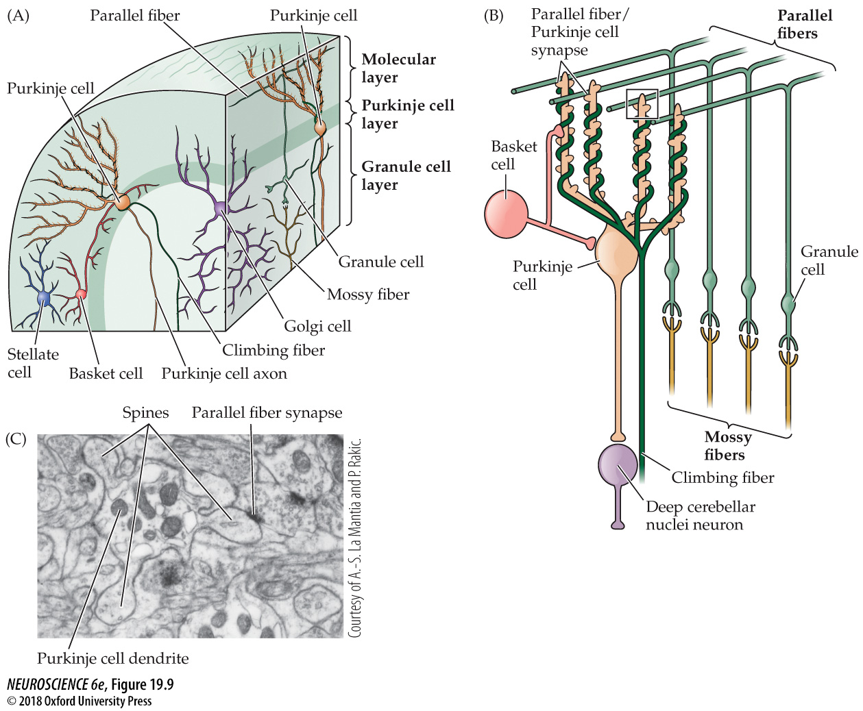
Neurons and circuits of the cerebellum

Slide 19
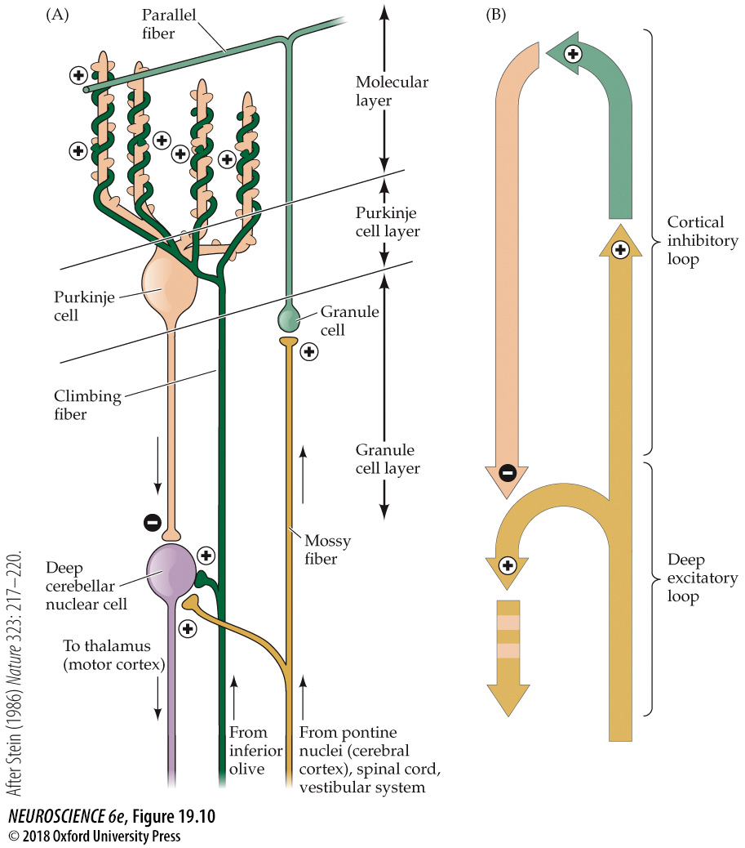
Excitatory and inhibitory connections in the cerebellar cortex and deep cerebellar nuclei

Slide 20
Purkinje Cell
Weak excitation from as many as 800,000 granule cell axons (parallel fibers) that end on its dendritic spines
Very strong excitation, overriding everything-else, is exerted by a single climbing fiber that runs over the soma and the entire dendritic tree

Slide 21
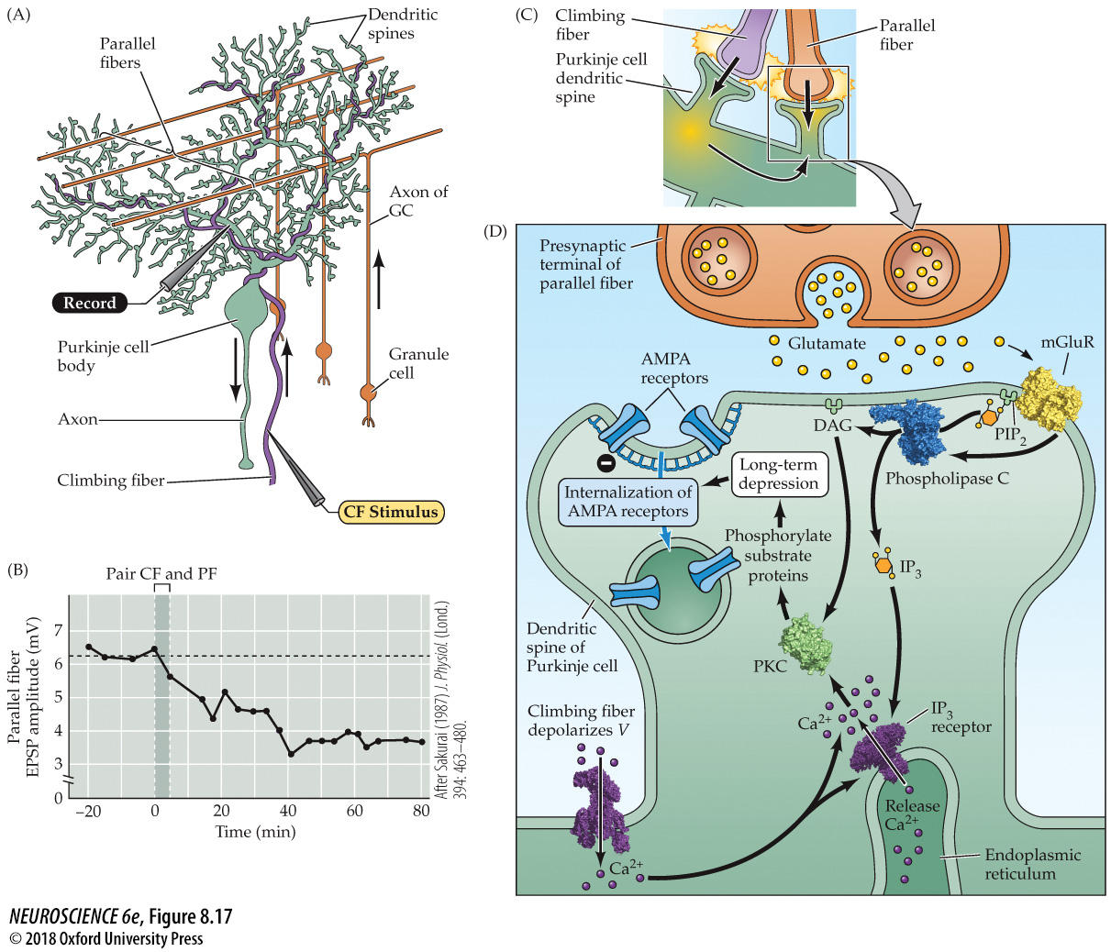
Long-term synaptic depression in the cerebellum

Slide 22
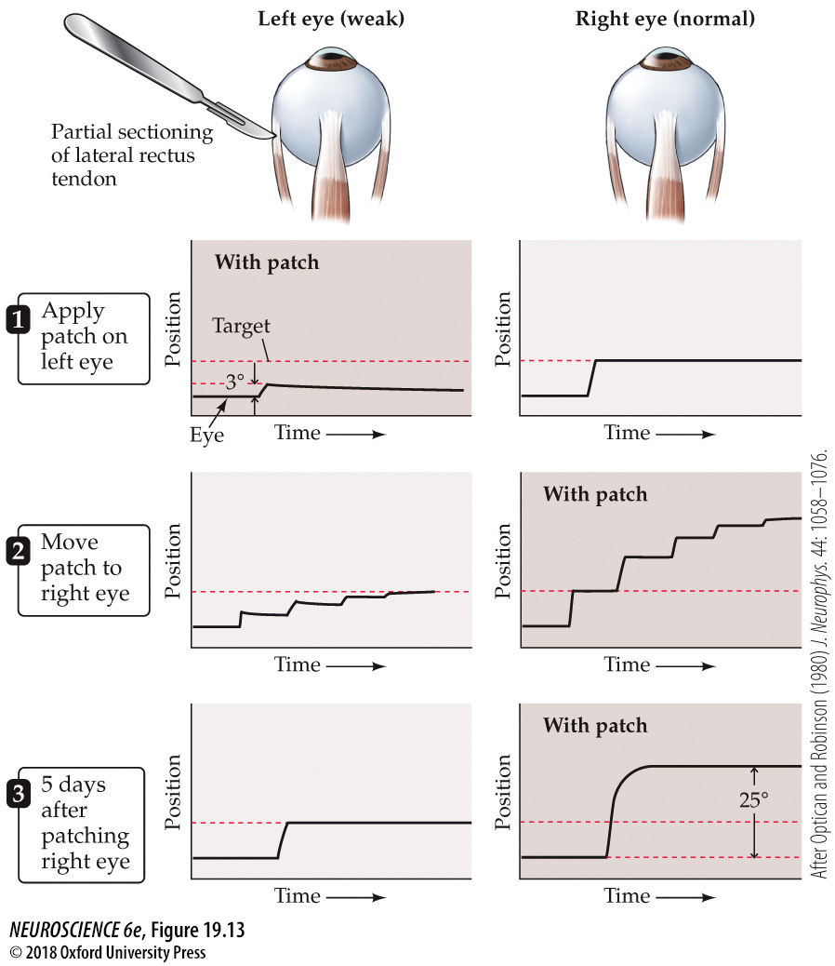
Contribution of the cerebellum to experience-dependent modification of saccadic eye movements

Slide 23
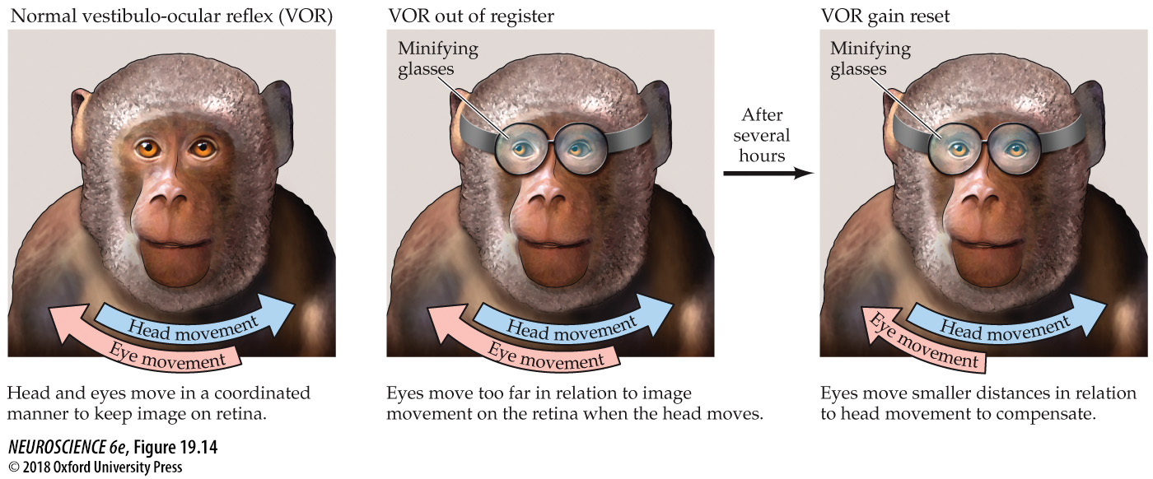
Learned changes in the vestibulo-ocular reflex in monkeys

Slide 24
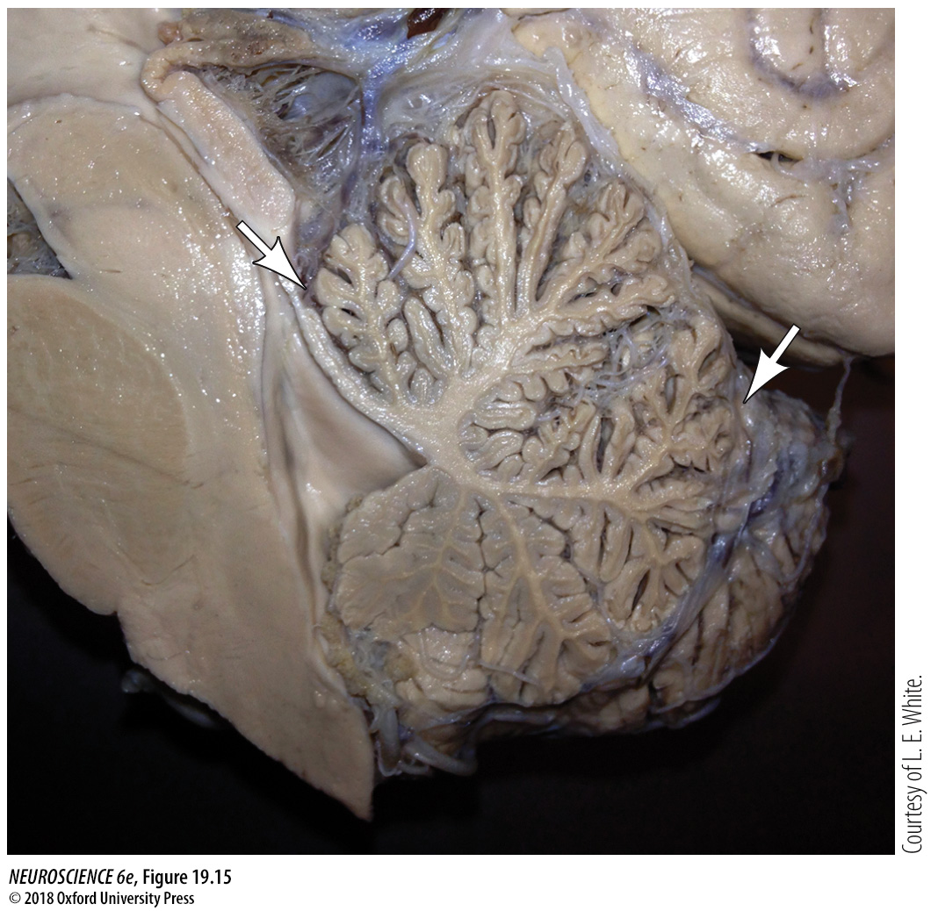
Chronic Alcohol Abuse

Slide 25
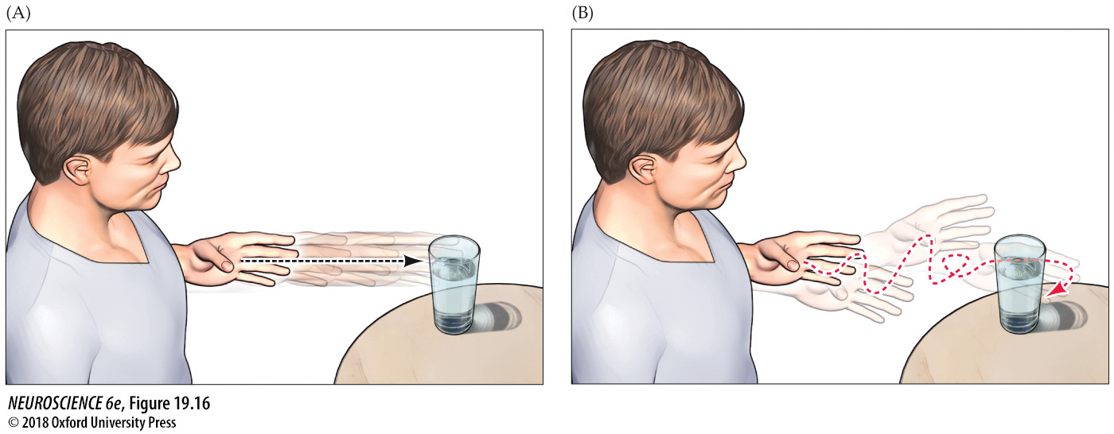
Appendicular Ataxia

